Slide 1
Microsoft IoT
Digital Transformation and the Internet of Things
Mike Chan
Cloud Solution Architect – Data & AI
MSHK, OCP

Slide 2
Microsoft IoT

Slide 3
IoT and Data – Fueling the digital era
73%
of companies surveyed are actively investing in IoT*
70%
of value enabled by IoT will come from B2B scenarios
McKinsey & Company
180 ZB
digital data created by 2025 - IDC
80B
connected “things” by 2025 - IDC
* Keystone Strategy, 2016

Slide 4

Innovation at Work – Real IoT Use Cases
Agriculture
Buildings
Airplanes
Livestock
Auto
Surveillance
Construction
Workspaces
Charging stations
Location
Buses
Sports
Trains
Worker Safety
Racing
Elevators
Security
Pets
Subways
Factories
Vending
Medical devices
Shopping
Power Plants
Equipment
Manufacturing
Engines
Vaccine dispensers
Traffic Systems
Postboxes
Communications
Weather Systems
Shipping
Smart meters
Smart grids
Trucks
Freight
Public Safety
Notes:
Added cow icon

Slide 5

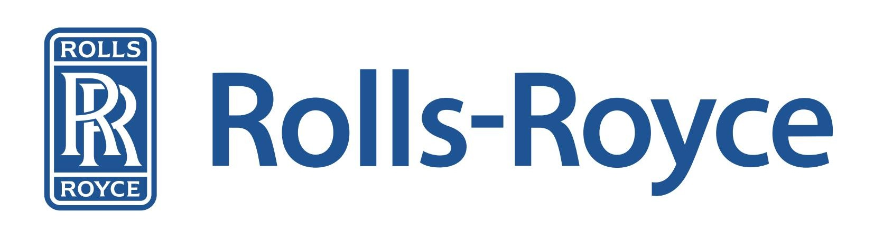
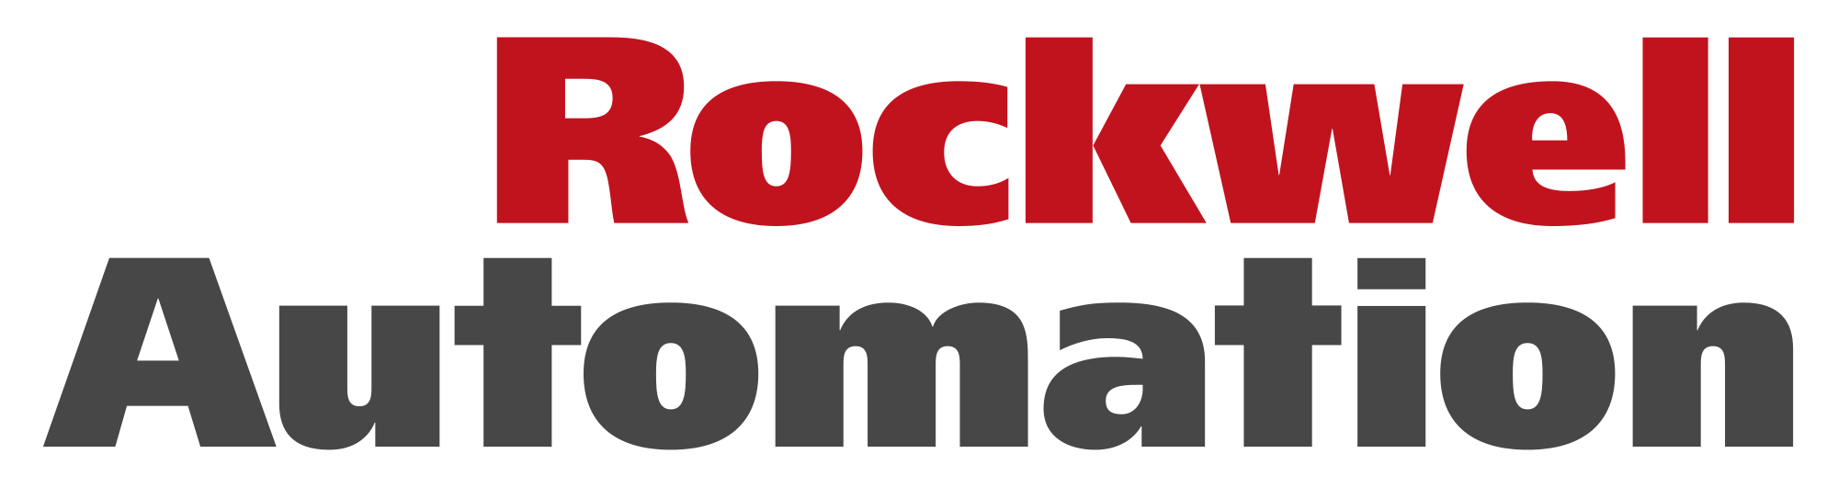

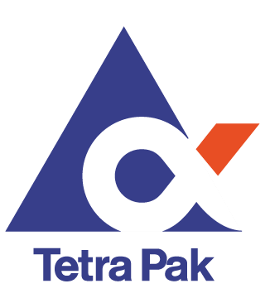
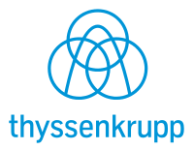

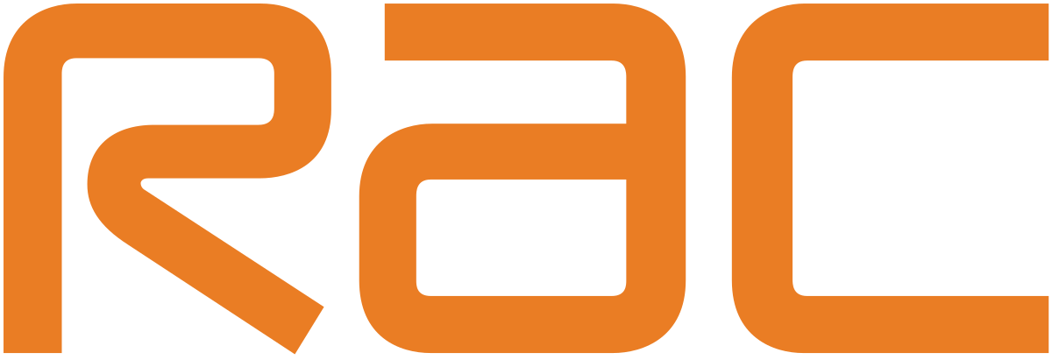
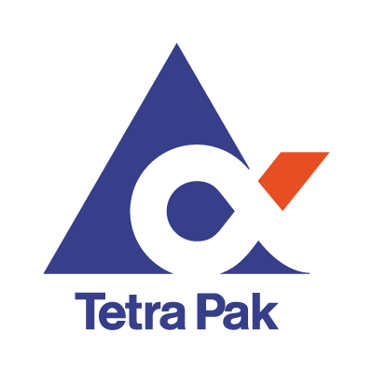




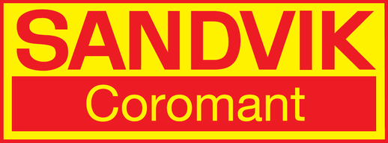

Connected chillers come back online 9x faster than unconnected equipment, avoiding more than $300,000 in hourly downtime costs
Rolls Royce provides maximize aircraft availability by employing “power by the hour” model. Cutting fuel usage by 1 percent could save $250,000 per plane per year
Keeping farmers informed about when to irrigate, how to control diseases, and fighting pests, has led to increased yields of 30%, and a 20% reduction in water use.
Improves access to production and supply chain data worldwide, reducing downtime costs by as much as $300,000 per day
Licorice extruders on Twizzler’s production line are performing at peak optimization, saving over $500K/year on materials alone
Tetra Pak’s has cut down-time cut down for each packaging line by up to 48 hours, saving €30,000 for customers.
RAC has reduced its accident rate by 25% and fuel usage by 20%, reporting annual savings of $1.8 million
Gathers data from sensors and systems to create valuable business intelligence and reduce downtime by 50%
Notes:
30 BYE WORDS
Speaker Notes:
Businesses move at the speed of thought and the competitive edge is measured in seconds and minutes—not days or weeks. The first and second consideration for holistic defense for businesses is data protection and business continuity. For enterprises—regardless of industry—there exists a set of common objectives for thriving in the digital landscape. Organizations that want to succeed tend to focus on:
Limiting downtime
Line of business applications are the lifeblood of modern enterprise and just a minute of downtime is far too long. Companies that want to succeed do everything in their power to achieve “the nine’s” of availability and uptime.
Reducing costs
Selling and increasing revenue are only part of the equation. Enterprises always look for ways to reduce costs and unnecessary overhead.
Managing complexity
Navigating some modern IT environments can be like making your way through a labyrinth. Primary, secondary, and tertiary data centers, DR protocols, heterogeneous operating environments, colocation facilities, disparate toolsets, it’s a lot to keep track of. Enterprises often look for ways to untangle the knot of 21st Century IT.
Ensuring compliance
With modernization and globalization of business—and the vast array of business models and industries--oversight is required. Businesses need to adhere to complex (and sometimes confusing) compliance mandates from many different regulatory bodies based on a number of factors—or risk costly litigation and negative effects to their brand and bottom line.
Scaling protection
It’s a given that enterprises need protection when the unthinkable happens. But more than that, they need holistic defense solutions that can continue to protect them as they grow. In short, they need scalable, complete protection from human and natural disaster.

Slide 6
Defining IoT
Things
Insights
Action
Notes:
Talking Points
The truth is, there is no standard definition for the Internet of Things. If you have heard or read about IoT, chances are you’ve come across a number of different perspectives
Despite how complex IoT seems, it essentially comes down to three areas:
Physical “things” such as line of business assets, including industry devices or sensors (e.g. Windows 10 IoT, Azure IoT Device & Gateway SDK). Those “things” have connectivity to the internet, to each other, and to people. Microsoft enables connectivity to any kind of device that our customers needs. And we can bring amazing experiences to the edge through our gateway SDK, and through intelligent devices with Windows 10 IoT. Those “things” collect and communicate and control data—this may include information gathered from the environment or inputted by users (Azure Data Lake, SQL Server 2016)
And then there are Insights gleaned from that data to provide insights (Cortana Intelligence Suite, SQL Server 2016, R-Server)
Lastly, insights does not impact bottom line unless we take action (Dynamics 365, Microsoft Flow)

Slide 7
A comprehensive portfolio
Microsoft IoT offerings
Certified IoT devices
Azure IoT SDK
Windows 10 IoT Core
Microsoft IoT Central
Azure IoT Suite
Azure IoT Hub
Device Provisioning Service
Azure Stream Analytics
Azure Time Series Insights
Azure Machine Learning
Dynamics 365
Power BI
Azure Logic Apps
Microsoft Flow
Things
Insights
Action

Slide 8
IoT Device Management Lifecycle
Check next slide for graphic – example of DM working via Firmware update operations
Replace or decommission devices after failure, upgrade cycle or service lifetime
Group devices and control access according to your organization's needs
Retire
Plan
Monitor device inventory, health and security while providing proactive remediation of issues
Securely authenticate devices, on-board for management and provision for service
Monitor
Provision
Configure
Provide updates, configuration and applications to assign the purpose of each device
Notes:
Talk about IoT Hub device management and IoT Hub Device Provisioning Service in the context of device lifecycle.

Slide 9

IoT projects can be complex
Difficult to maintain cohesive security
Time-consuming to stand up
Incompatible with current infrastructure
Hard to scale

Slide 10
Microsoft is simplifying IoT
On-premises and hybrid cloud
Platform as a Service
Software as a Service
Azure IoT Edge
Securely distribute cloud intelligence locally, quickly, and at scale
Azure IoT Suite
Fully customizable PaaS for when you need complete control. Preconfigured solutions to help accelerate the most common scenarios
Microsoft IoT Central
A fully managed SaaS solution for the Internet of Things. Get started quickly with minimal experience.

Slide 11
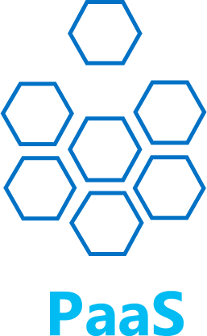
Expedite your IoT journey with a solutions approach
SaaS – Microsoft IoT Central
Fully managed IoT SaaS
No cloud solution development expertise required
Configurable to your needs
Ideal for straightforward IoT needs
PaaS – Azure IoT Suite
Preconfigured solutions
Deploy in minutes
Accelerate time to value
Ideal for solutions that require ultimate control
Notes:
Microsoft has built a portfolio that supports the needs of all customers, and enables everyone to access the benefits of digital transformation.
Microsoft IoT Central is a fully managed SaaS solution that is best used when you need to get started quickly with minimal IoT experience. If your business is pursuing speed over customization, SaaS models could be the perfect fit for your IoT implementation needs. Organizations with fewer device models, more predictable scenarios, and limited IoT/IT capabilities can now reap the benefits of IoT through a SaaS approach. Those businesses that previously lacked the time, money, and expertise to develop connected products can now get started quickly with Microsoft IoT Central. We are leading the industry in providing a mature SaaS solution that meets common IoT implementation pain points.
Azure IoT Suite is a customizable PaaS solution that is best used when you need a lot of control over your IoT solution. If your business is implementing IoT for connected operations, or have very particular customization requirements for your connected products, you can have the control you need with Azure IoT Suite. Organizations with a large number of devices or device models, and manufacturers seeking connected factory solutions are examples of companies that can create highly customizable IoT solutions tailored to their complex needs.
In addition, Azure IoT Edge provides organization with the capacity to do local processing. When combined with a PaaS or SaaS solution, edge processing can offer faster calculations and reduce the cost of data sent to the cloud.
For the remainder of this presentation, we’ll focus on Microsoft IoT Central, and the unique value that it is bringing by democratizing IoT.
<click>

Slide 12
Both approaches use the same Azure services
Azure IoT Hub
Azure Stream Analytics
Azure Time Series Insights
Azure Machine Learning
Azure Logic Apps
More..
Notes:
Microsoft has built a portfolio that supports the needs of all customers, and enables everyone to access the benefits of digital transformation.
Microsoft IoT Central is a fully managed SaaS solution that is best used when you need to get started quickly with minimal IoT experience. If your business is pursuing speed over customization, SaaS models could be the perfect fit for your IoT implementation needs. Organizations with fewer device models, more predictable scenarios, and limited IoT/IT capabilities can now reap the benefits of IoT through a SaaS approach. Those businesses that previously lacked the time, money, and expertise to develop connected products can now get started quickly with Microsoft IoT Central. We are leading the industry in providing a mature SaaS solution that meets common IoT implementation pain points.
Azure IoT Suite is a customizable PaaS solution that is best used when you need a lot of control over your IoT solution. If your business is implementing IoT for connected operations, or have very particular customization requirements for your connected products, you can have the control you need with Azure IoT Suite. Organizations with a large number of devices or device models, and manufacturers seeking connected factory solutions are examples of companies that can create highly customizable IoT solutions tailored to their complex needs.
In addition, Azure IoT Edge provides organization with the capacity to do local processing. When combined with a PaaS or SaaS solution, edge processing can offer faster calculations and reduce the cost of data sent to the cloud.
For the remainder of this presentation, we’ll focus on Microsoft IoT Central, and the unique value that it is bringing by democratizing IoT.
<click>

Slide 13
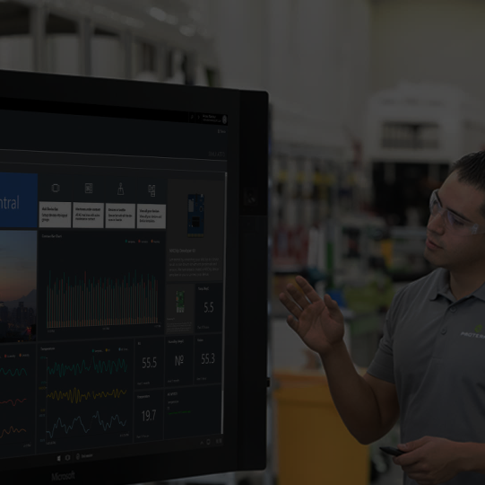
Fully hosted and managed by Microsoft
No cloud development expertise required
Device connectivity and management
Microsoft IoT Central
Monitoring rules and triggered actions
User roles and permissions
Analytics, dashboards and visualization
Risk-free trial with simplified pricing
Notes:
Reduces the complexity of IoT solutions with a ully managed SaaS offering for customers and partners that enables powerful IoT scenarios without requiring cloud solution expertise.
Simplifies the development process and makes it easy and fast for customers to get started, making digital transformation more accessible to everyone.
Available along with our existing platform-as-a-service (PaaS) solution, Azure IoT Suite, which enables deep customization and full control.

Slide 14
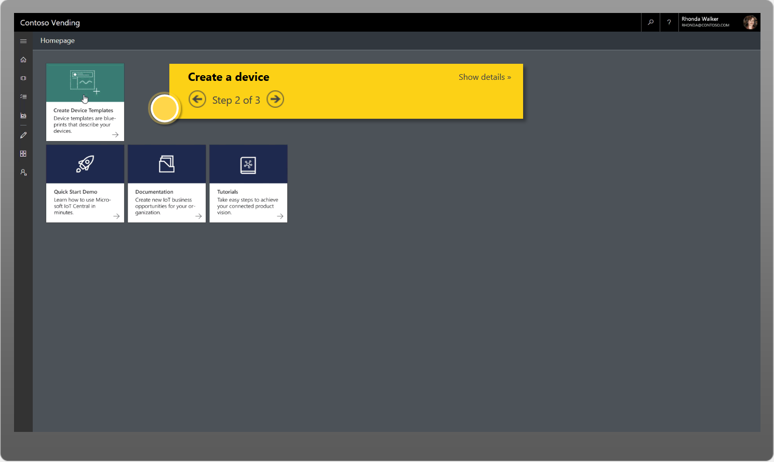
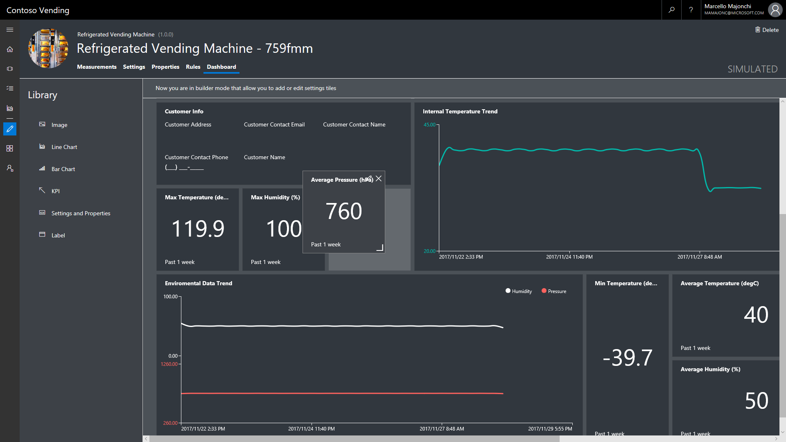
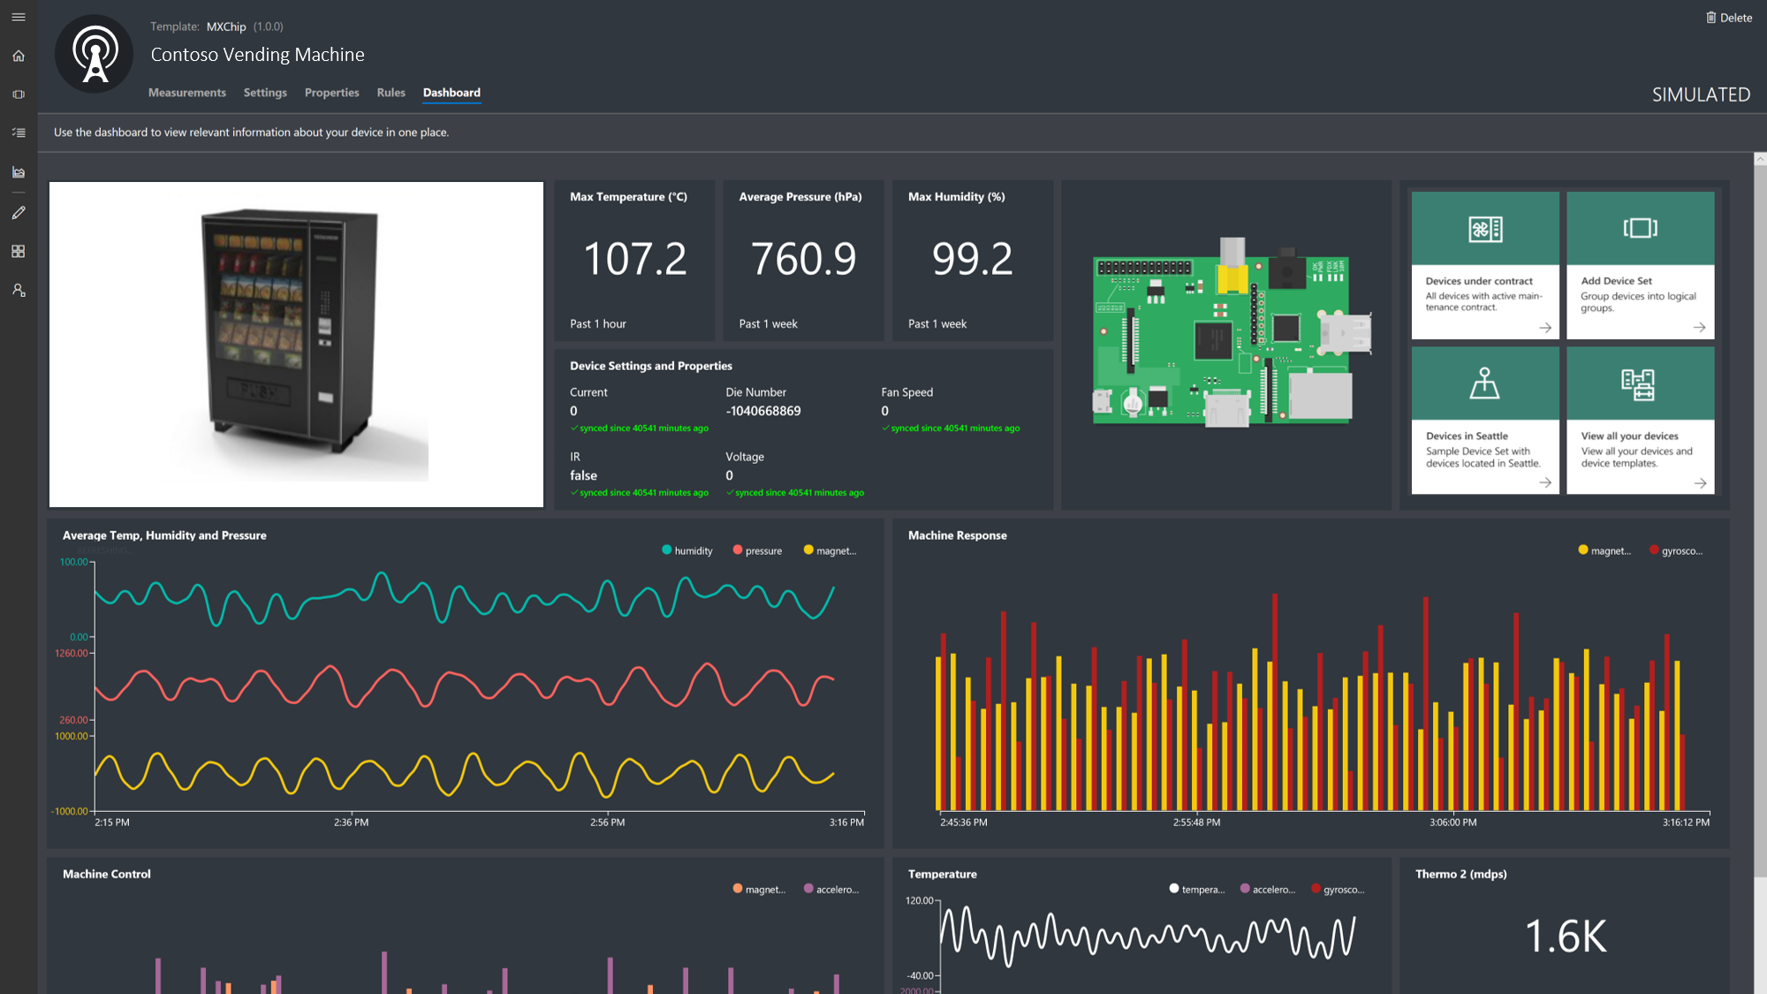
Builder
Operator
Product Modeler
Device management
Device settings
Analytics & dashboards
Template Management
Time-series Insights
Rules Workflows
Alerts and actions
User and identity management

Slide 15
The industry’s most comprehensive portfolio
Solutions (PaaS)
Solutions (SaaS)
Azure IoT Suite (PaaS)
Preconfigured solutions for common IoT scenarios
Microsoft IoT Central
IoT SaaS
Microsoft Dynamics Connected Field Service
Technologies (PaaS)
Device support
IoT
Edge
Data and Analytics
Visualization and Integration
Azure IoT Device SDK
Azure IoT Hub
Azure Stream Analytics
Azure HD Insight
Microsoft Flow
Azure Active Directory
Azure IoT certified devices
IoT Hub Device Provisioning Service
Azure Time Series Insights
Azure Data Lake Analytics
Azure Logic Apps
Microsoft Power BI
Security Program for Azure IoT
Azure Machine Learning
Azure Data Lake
Notification Hubs
Azure Monitor
Windows 10 IoT
Azure IoT Edge
Cosmos DB
Azure Websites
Visualization and Integration Services

Slide 17
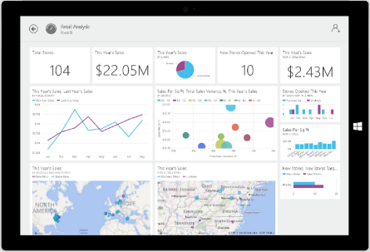
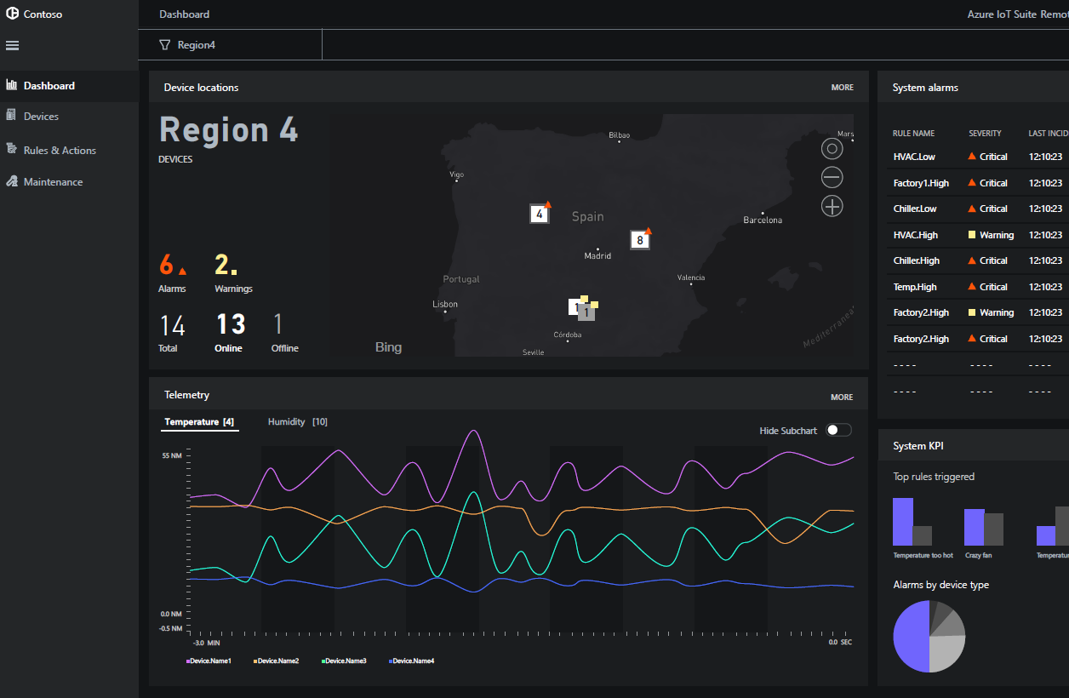
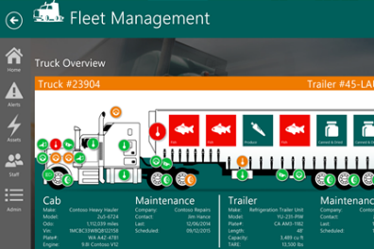
Preconfigured Solutions - Accelerate time to value
Start quickly for common IoT scenarios
Finish with your IoT application
Get started in minutes
Modify existing rules and alerts
Add your devices and begin tailor to your needs
Fine-tuned to specific assets and processes
Highly visual for your real-time operational data
Integrate with back-end systems

Slide 18

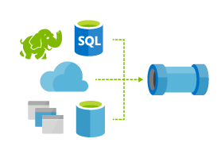



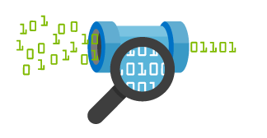






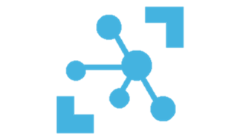

The Azure IoT Ecosystem
Cold Path Analytics
Azure HDInsight, AzureML
Azure Data Lake, Data Lake Analytics
Cloud Gateway
IoT Hub
Hot Path Analytics
Azure Stream Analytics
Azure HDInsight Storm
Bi-directional device-cloud
Telemetry ingestion
Command & Control
Device Registry & Identity
Device Mgmt
HTTP / AMQP / MQTT
IoT Hub Routing
Power BI
Hot Path Business Logic
Service Fabric &
Actor Framework
Azure IoT Edge Gateway
App Service
Web Apps
Mobile Apps
Analytics/ML
Custom Code
Devices
RTOS, Linux, Windows, Android, iOS
Warm Path Analytics
Time Series Insights
Protocol Adapter
Logic Apps
Notification Hubs
BizTalk Services
Presentation &
Business Connectivity
Device Connectivity
Data Ingestion & Processing, Command and Control

Slide 19
Azure IoT : Ready for the enterprise
Secure
End-to-end
Fast
Start in minutes
Open
Connect anything
Scalable
Grow effortlessly
From endpoint and connection through to data and the cloud
Solutions for the most common IoT scenarios
Any device, OS, data source, software, or service
Millions of devices, terabytes of data, on-premises and in the cloud, in 30 regions worldwide

Slide 20




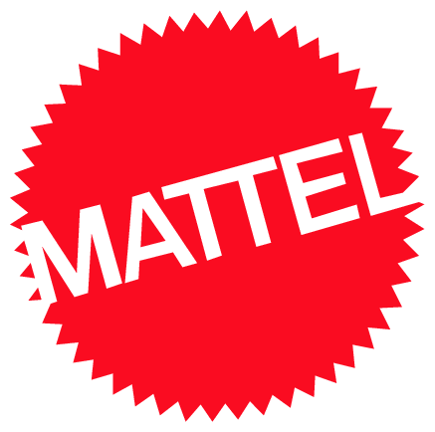






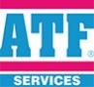
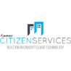




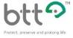



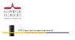


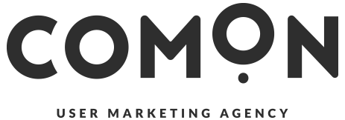



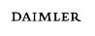







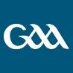
























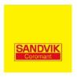












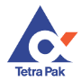

100s of Real IoT Solutions and Use Cases

Slide 21
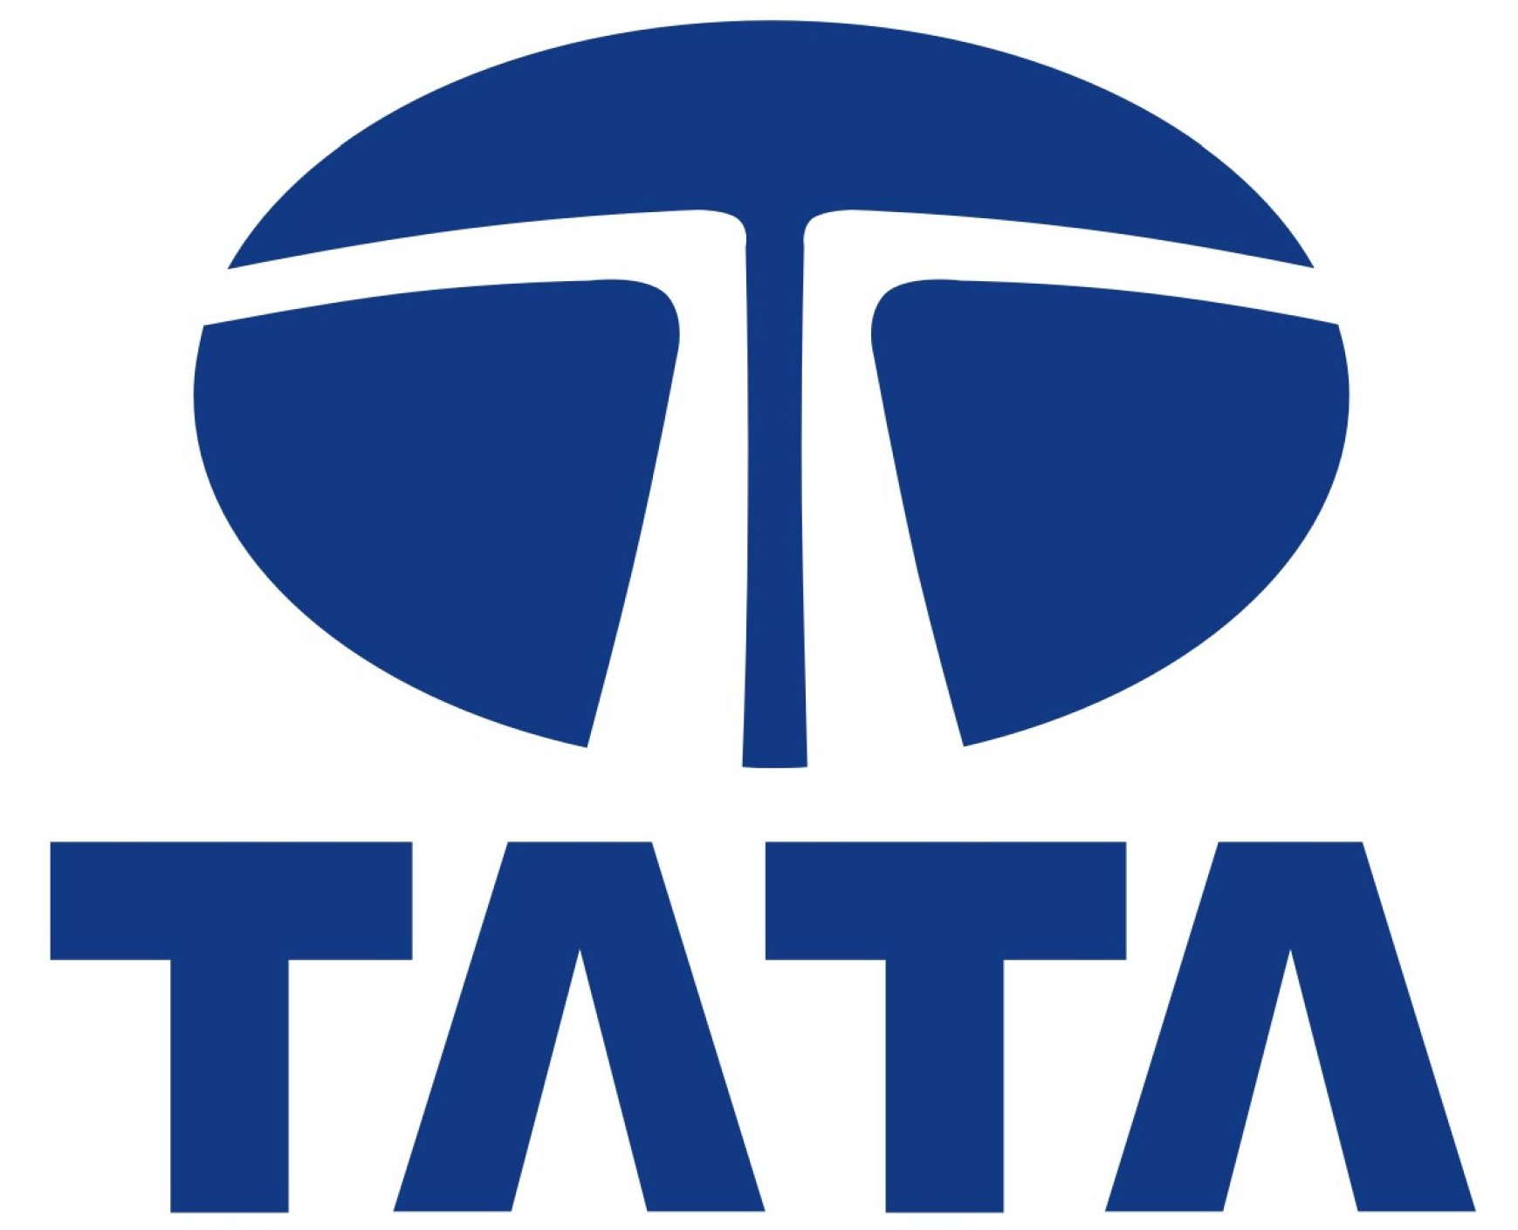
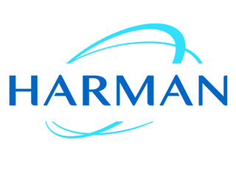
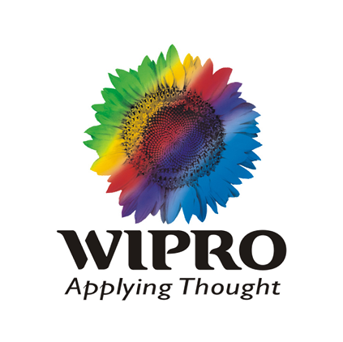





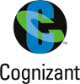







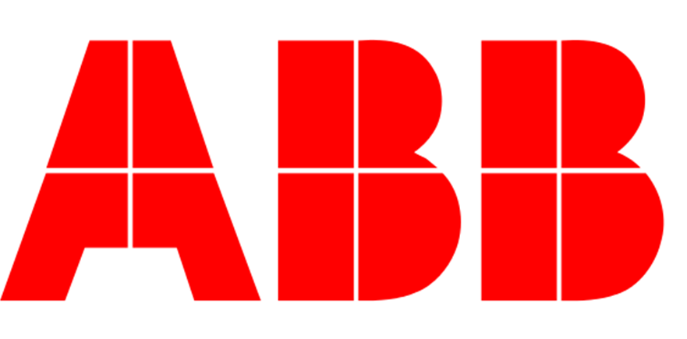











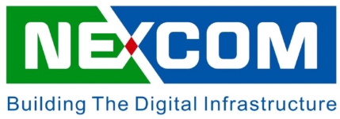
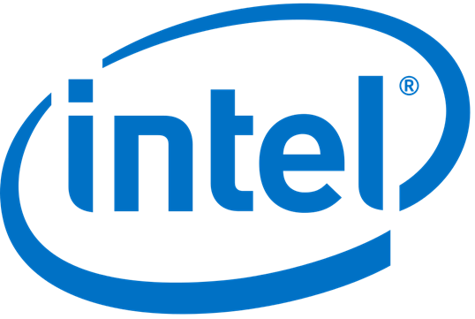


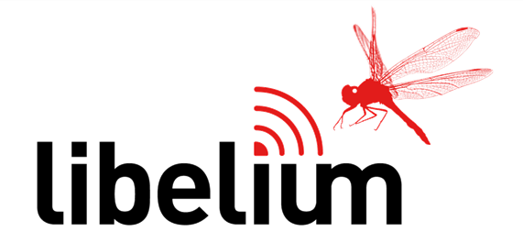
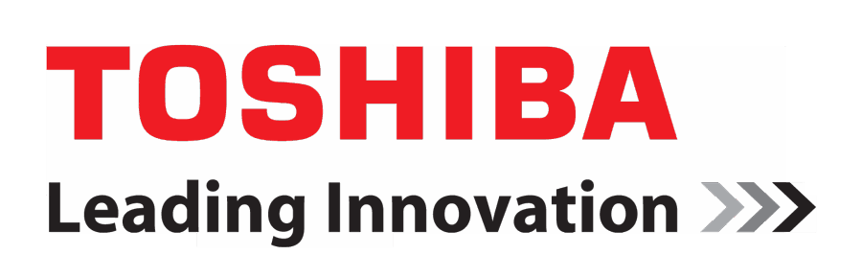


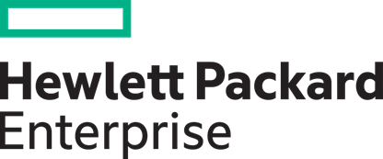

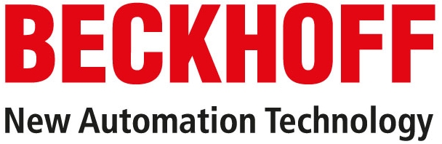


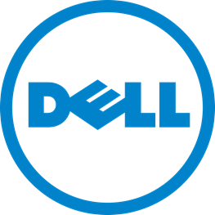
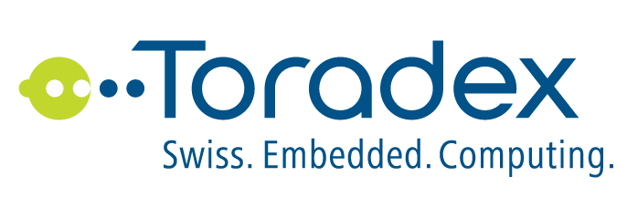
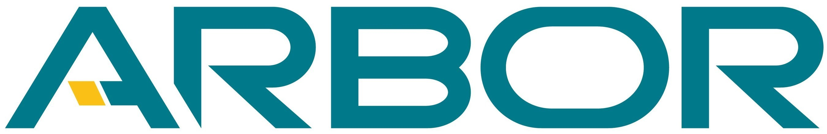









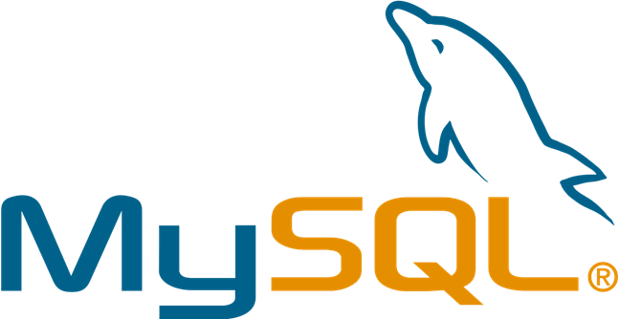


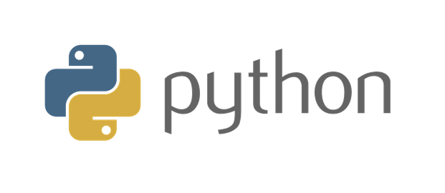



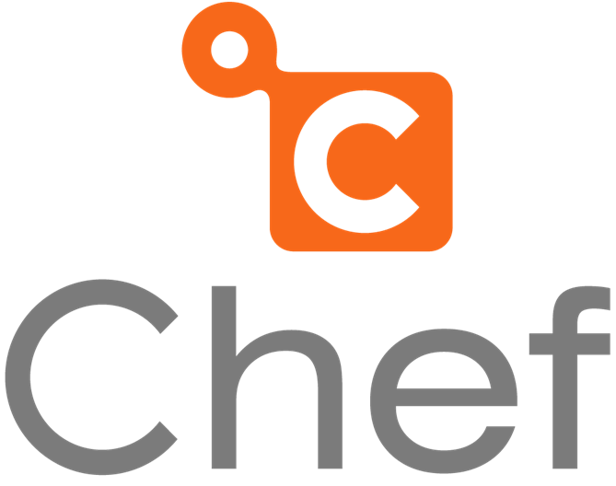
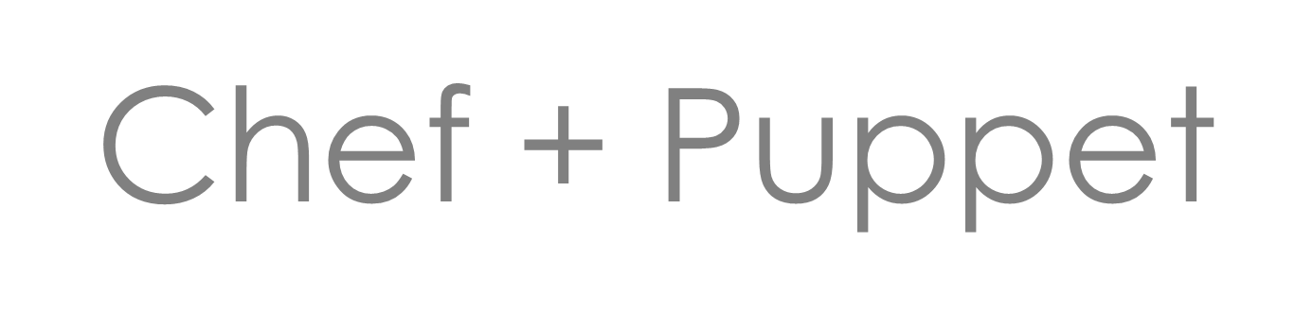
A large and growing ecosystem
System integrators
Solution
providers
Azure certified for IoT
Developer, IT and productivity

Slide 22
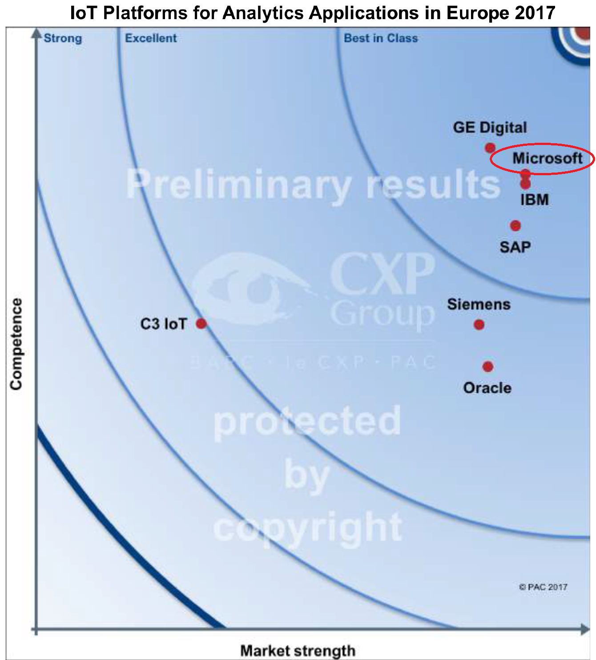
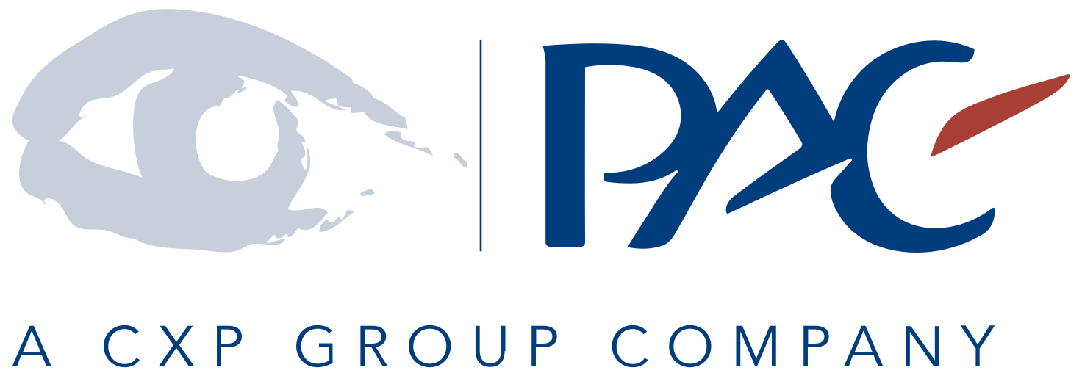
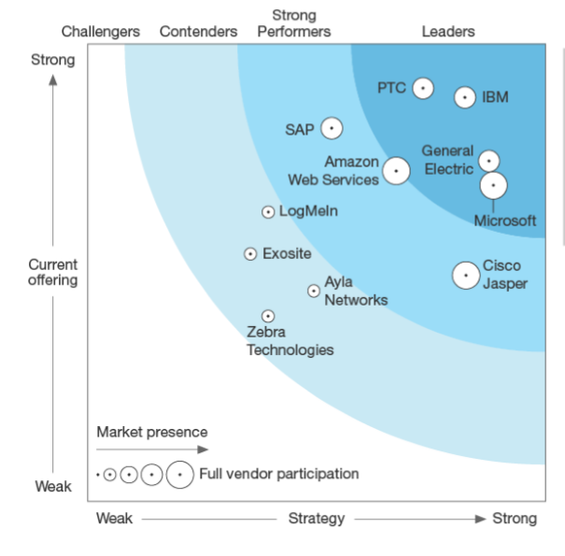
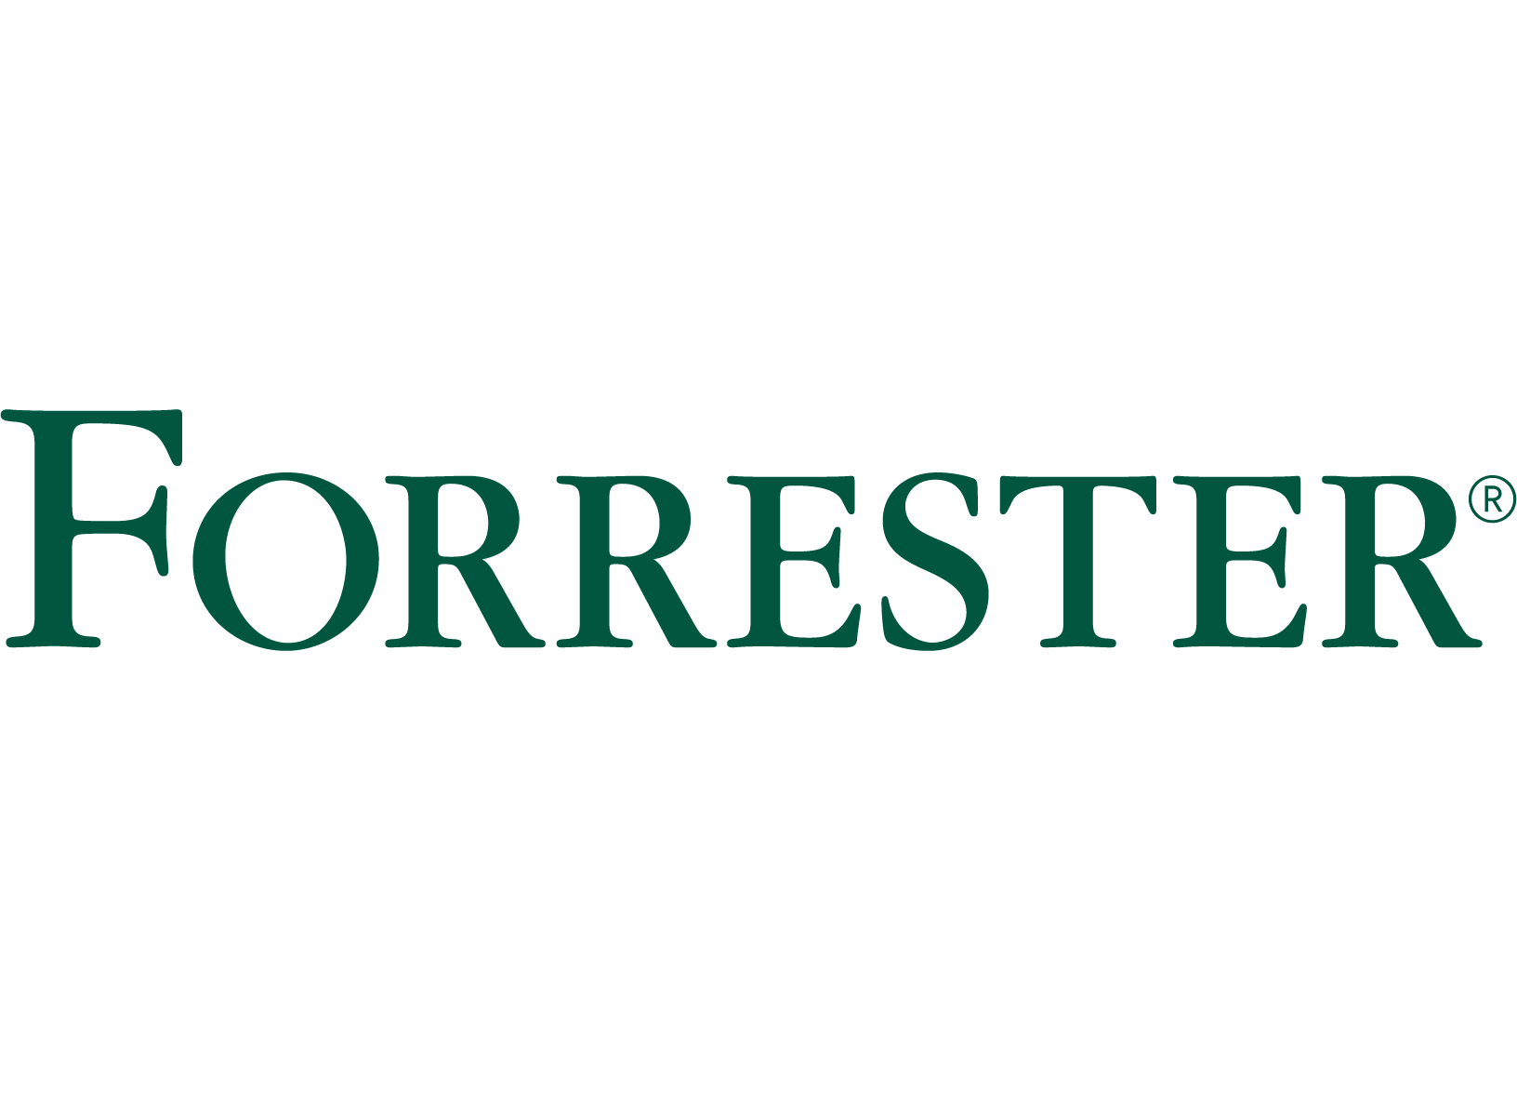


Microsoft is leading the industry
Many industry firsts…
The first IoT hyperscale cloud to:
Offer both IoT SaaS and PaaS
Deliver preconfigured solutions
Extend AA/AI to the edge
Solve device provisioning at scale
Launch a security program
Support OPC UA
Announce a Connected Vehicle Platform
provide the most regions of dedicated IoT service
…and we’re just getting started
Azure IoT is the only cloud platform that was determined as best in class in every category
Microsoft a is leader in the Q4 2016 Forrester Wave for IoT Software Platforms
Microsoft is a leader in the Research Leaderboard assessment of strategy and execution for 15 IoT platform providers

Slide 23

Q4 2019 – Microsoft Leading
Notes:
https://reprints.forrester.com/#/assets/2/108/RES146958/reports

Slide 24

Built on an industry’s leading hyperscale cloud…
57
Azure regions around the world
Azure regions
More than AWS and Google Cloud combined
Gartner Magic Quadrant leader, Business Intelligence and Analytics Platforms, 2017
Notes:
Azure is continuing expand its infrastructure footprint around the globe.
In fact, Microsoft is the first cloud provider to put data centers in South Africa.
Right now, we’re at 42 Azure regions—which is more than AWS and Google combined.
The approach Azure takes is different as it is important for enterprise customers to have data in region, close to employees, close to customers as well as have unique data handling capabilities.

Slide 25
Reference Architecture

Slide 26
Architectures
Azure IoT Reference Architecture
https://docs.microsoft.com/en-us/azure/architecture/reference-architectures/iot/
Internet of Things Security Architecture
https://azure.microsoft.com/en-us/documentation/articles/iot-security-architecture/

Slide 27
Azure IoT Reference Architecture
Device Connectivity
Data Processing, Analytics and Management
Presentation & Business Connectivity
IP capable devices
Cloud Gateway
Provisioning API
App Backend
Solution UX
Personal mobile devices
IoT Client
Identity and Registry Stores
Device State Store
Existing IoT devices
Stream Processors
Business Integration Connectors and Gateway(s)
IoT Client
Gateway
Business systems
Low power devices
Storage
Analytics & Machine Learning
IoT Client
Data Path
Optional solution component
IoT solution component

Slide 28

Reference Architecture – Azure Services

Slide 29


Transforming in vitro diagnostic medical devices with Microsoft IoT
Improving patient health and medical treatment decisions
Roche uses an IoT platform to connect and manage its IVD devices intelligently and remotely. In turn, these capabilities enable the company to collect operational data, such as location, in near-real time from those devices. The company can now assess each IVD system's health data, troubleshoot any issues, and if problems exist, can trigger alarms to alert and dispatch supporting teams for service. Furthermore, health providers are able to make more effective decisions on what medical devices to employ from the wealth of diagnostic data available.
Azure HDInsight
Azure IoT Hub
Azure Notification Hubs
Azure Storage
Azure Stream Analytics
Corporate
Healthcare
China
Cleidon
Remote Monitoring
Asset Optimization
Customer Insights

Slide 30


Hershey creates IoT solutions for sweeter success
Increasing efficiencies, optimizing processes, and decreasing ingredient waste
To improve efficiencies, optimize processes, and decrease ingredient waste, Hershey is expanding their Microsoft IoT solution, including Cortana Intelligence, from intelligent sensors on the factory line to packaging, transportation, and customer behavior.
Office 365
OneDrive for Business
SharePoint Online
Yammer
Azure,
Azure IoT
Azure IoT Hub
Microsoft AI
Corporate
Consumer Goods
United States
BrightStarr
Factory Optimization
Waste Reduction
Customer Insights

Slide 31



Becoming the world's first 'Smart Nation'
From building and construction management to reap energy and manpower savings from municipality owned buildings, to a completely connected transportation infrastructure enabled by an open 'data mall,' to connected hospital care for the elderly powered by big data and a fleet of IT partners, the Singapore government is well on the way in their IoT-enabled digital transformation journey.
Azure
Azure IoT Hub
Azure Machine Learning
Azure Stream Analytics
Azure Storage
Large (1,000 - 9,999 employees)
Government
Singapore

Slide 32


Crowne Plaza Belgrade differentiates guest service with smart parking solution
To offer a unique service in a highly competitive hospitality industry, Crowne Plaza partnered with DunavNET and created a smart parking solution powered by Microsoft Azure.
Now, busy guests and helpful staff can see parking availability in real time, ensuring a convenient arrival experience and saving everyone time. Building on that success, the hotel plans to explore and implement more IoT services in Azure.
“Using Azure, IoT, & ParkNET, we are striving for excellence, competitive leadership in the market, & innovation in our guest experience."
- Sasa Cvetkovic: Director of Engineering, Crowne Plaza Belgrade
Microsoft Azure
Azure IoT Hub
Azure SQL Database
Corporate (10,000+ employees)
Travel and transportation
Serbia
DunavNET
Notes:
https://customers.microsoft.com/en-us/story/crowneplazabelgrade-travel-transportation-azure

Slide 33



Maersk uses cloud to spur development of containerized solutions
Savings on resource costs, faster solution delivery time, and attract expert IT talent.
As part of its digital transformation efforts, shipping giant A.P. Moller - Maersk needed to streamline IT operations and optimize the value of its IT resources. Maersk adopted Microsoft Azure, migrated key workloads to the cloud, and modernized its open-source software, which included the adoption of Kubernetes on Azure. Maersk software engineers now spend less time on container software management and more time on innovation and value-added projects. The resulting business value is savings on resource costs, faster solution delivery time, and the ability to attract expert IT talent.
Azure
Azure IoT Hub
Corporate
Transportation
Denmark
Connected vessel

